Slide 1
Fractions
Review and Applications
Presented by the Quantitative Success Center

Slide 2
What is a fraction?
Let’s remind ourselves…
A fraction represents parts of a whole.
It consists of a numerator and denominator like so:
Fractions can be reduced/simplified by canceling common factors.
The most simplified fraction will not have any common factors,
apart from 1, in the numerator and denominator. We can always turn a whole number into a fraction by putting it over 1.

Slide 3
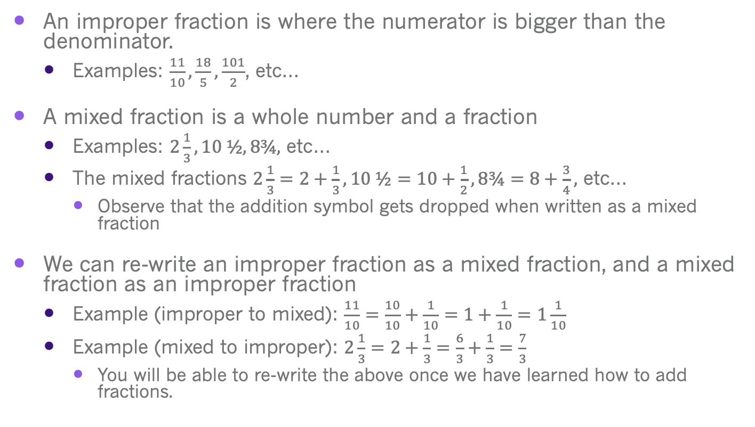
Improper vs Mixed
Fractions
An improper fraction is where the numerator is bigger than the denominator.
  Examples: $\frac{11}{10},\frac{18}{5},\frac{101}{2}$, etc…
A mixed fraction is a whole number and a fraction
  Examples: $2\frac{1}{3}, 10 ½, 8¾,$ etc…
  The mixed fractions $2\frac{1}{3}=2+\frac{1}{3}, 10 ½=10+\frac{1}{2},8¾=8+\frac{3}{4},$ etc…
    Observe that the addition symbol gets dropped when written as a mixed fraction
We can re-write an improper fraction as a mixed fraction, and a mixed fraction as an improper fraction
  Example (improper to mixed): $\frac{11}{10}=\frac{10}{10}+\frac{1}{10}=1+\frac{1}{10}=1\frac{1}{10}$
  Example (mixed to improper): $2\frac{1}{3}=2+\frac{1}{3}=\frac{6}{3}+\frac{1}{3}=\frac{7}{3}$
    You will be able to re-write the above once we have learned how to add fractions.

Slide 4

Slices of Pizza
Let’s divide a whole pizza into 8 equal slices.
If someone eats 1 slice of pizza and someone else eats 3 slices of pizza, how much of the pizza has been eaten?
Intuitively, we know that means 4 slices were eaten, so 4 out of 8 slices of pizza means half of the pizza was eaten. Let’s look at the math.
1 slice of pizza = 1/8
3 slices of pizza = 3/8
Observe that when we add fractions, we add the values in the numerator straight across and leave the denominator alone.
We are able to apply this to subtracting fractions as well. Ex: $\frac{3}{8}−\frac{1}{8}=\frac{2}{8}$

Slide 5
What about adding/subtracting fractions that have different denominators?
For example, if ¾ of the pizza that has 8 slices has been eaten and someone eats 1 more slice, how much pizza has been eaten?
Although we can take a pizza and divide it into quarters to give 4 big slices, we know ¾ of pizza is equivalent to 6 out of 8 slices of pizza.
x2
x2
So
Observe that we get 6/8 from multiplying numerator and denominator by 2 to give us a common denominator of 8. So in order to add, or subtract, fractions with different denominators, we need a common denominator.

Slide 6
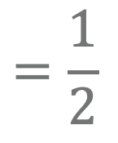
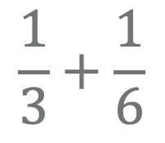
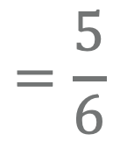
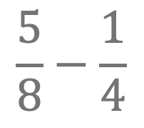
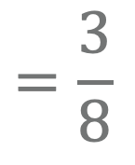
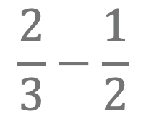
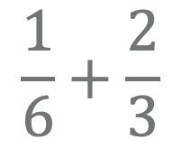
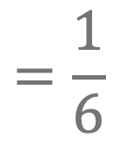
Fractions with Pies
$$\frac{5}{8}−\frac{1}{4}$$
$$=\frac{3}{8}$$
$$\frac{1}{6}+\frac{2}{3}$$
$$=\frac{5}{6}$$
$$\frac{1}{3}+\frac{1}{6}$$
$$=\frac{1}{2}$$
$$\frac{2}{3}−\frac{1}{2}$$
$$=\frac{1}{6}$$

Slide 7
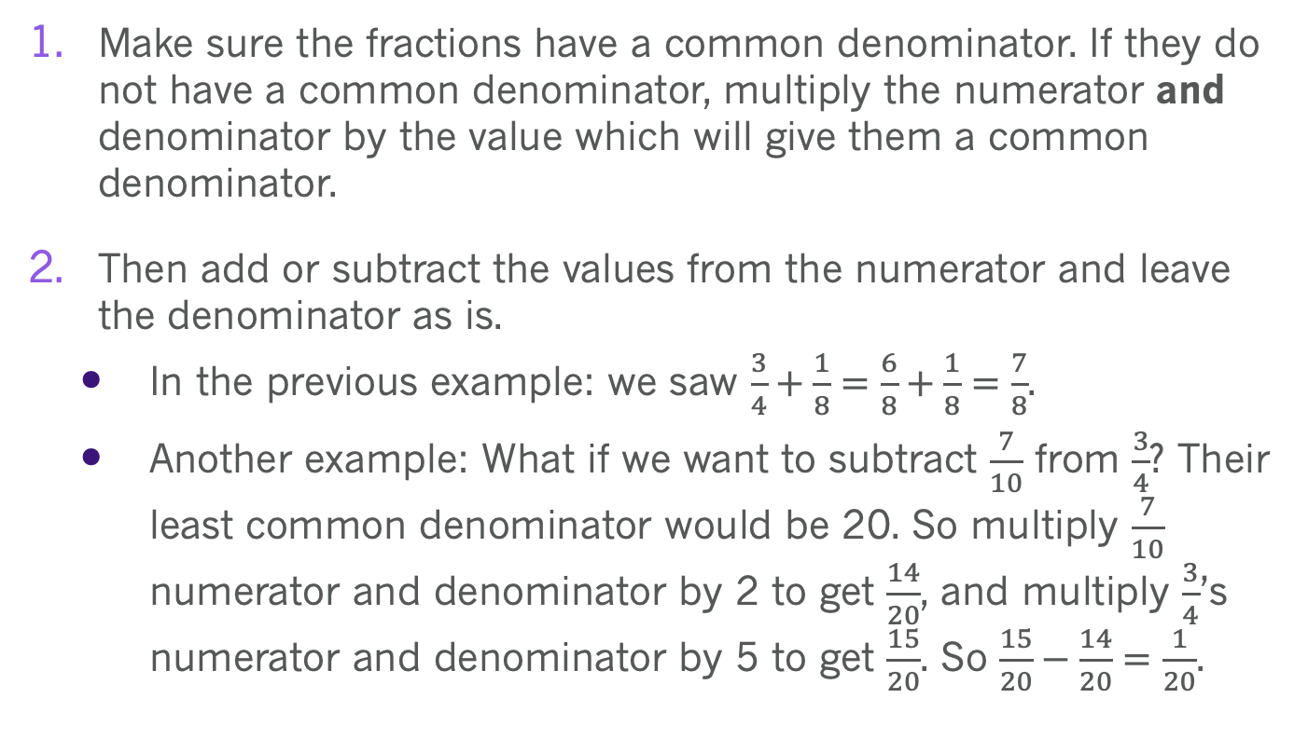
Rules for
Addition and Subtraction
Make sure the fractions have a common denominator. If they do not have a common denominator, multiply the numerator and denominator by the value which will give them a common denominator.
Then add or subtract the values from the numerator and leave the denominator as is.
  In the previous example: we saw $\frac{3}{4}+\frac{1}{8}=\frac{6}{8}+\frac{1}{8}=\frac{7}{8}$.
  Another example: What if we want to subtract $\frac{7}{10}$ from $\frac{3}{4}$? Their least common denominator would be 20. So multiply $\frac{7}{10}$ numerator and denominator by 2 to get $\frac{14}{20}$, and multiply $\frac{3}{4}$’s numerator and denominator by 5 to get $\frac{15}{20}$. So $\frac{15}{20}−\frac{14}{20}=\frac{1}{20}$.

Slide 8
Let’s Practice!

Slide 9
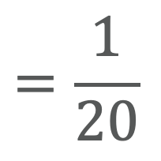
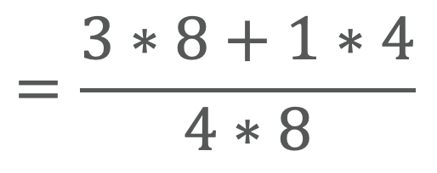
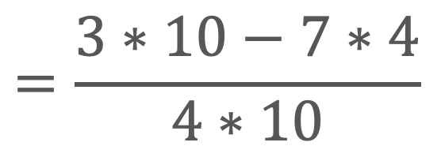
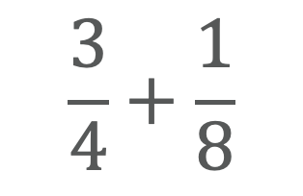
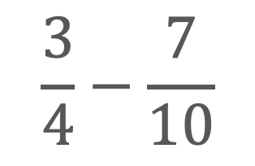
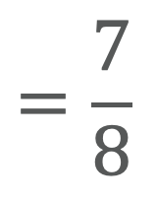
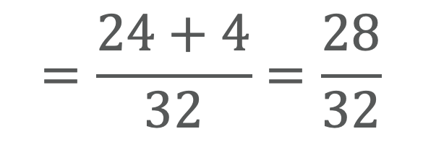
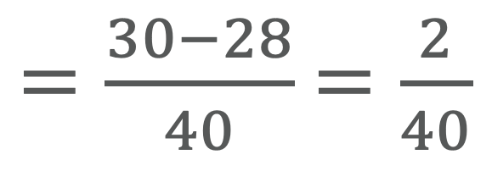
Butterfly Method for
Addition and Subtraction
$$\frac{3}{4}+\frac{1}{8}$$
$$=\frac{3∗8+1∗4}{4∗8}$$
$$=\frac{24+4}{32}=\frac{28}{32}$$
$$=\frac{7}{8}$$
$$\frac{3}{4}−\frac{7}{10}$$
$$=\frac{3∗10−7∗4}{4∗10}$$
$=\frac{30−28}{40}$ $=\frac{2}{40}$
$$=\frac{1}{20}$$

Slide 10
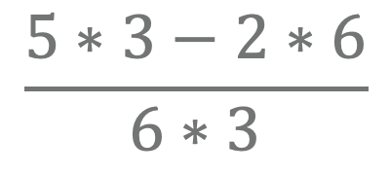
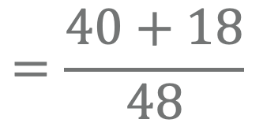
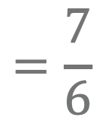
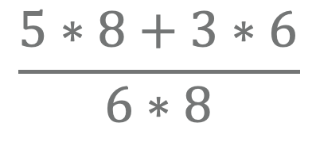
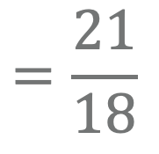
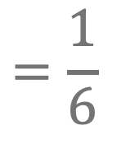
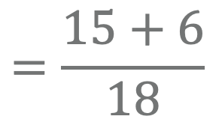
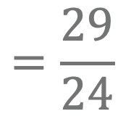
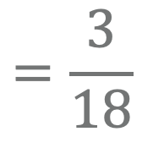
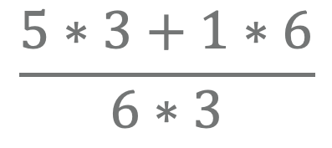
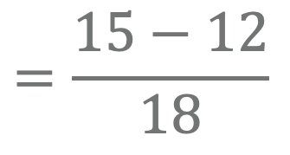
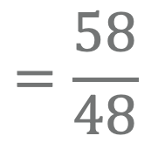
Let’s Practice!
$$\frac{5∗3+1∗6}{6∗3}$$
$$=\frac{15+6}{18}$$
$$=\frac{21}{18}$$
$$=\frac{7}{6}$$
$$\frac{5∗3−2∗6}{6∗3}$$
$$=\frac{15−12}{18}$$
$$=\frac{3}{18}$$
$$=\frac{1}{6}$$
$$\frac{5∗8+3∗6}{6∗8}$$
$$=\frac{40+18}{48}$$
$$=\frac{58}{48}$$
$$=\frac{29}{24}$$

Slide 11
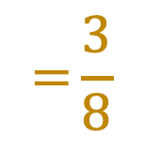
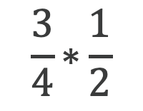
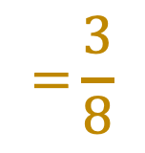
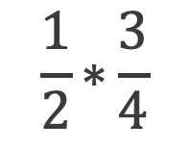
Multiplication with Slices of Pizza
$$\frac{\text{1}}{\text{2}}\text{∗}\frac{\text{3}}{\text{4}}$$
$$\text{=}\frac{3}{8}$$
Half of three fourths of a pizza
$$\frac{\text{3}}{\text{4}}\text{∗}\frac{\text{1}}{\text{2}}$$
$$\text{=}\frac{3}{8}$$
is the same as
three fourths of half of a pizza.

Slide 12
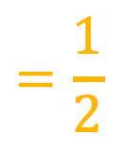
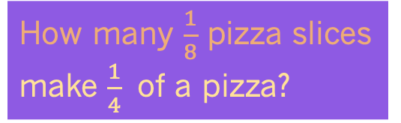
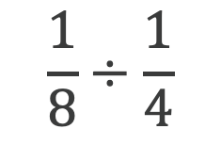

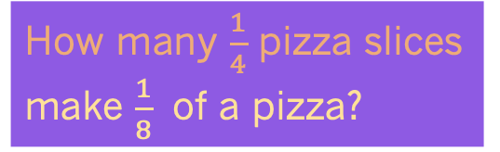
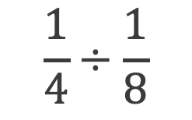


Division with Slices of Pizza
$$\frac{1}{4}÷\frac{1}{8}$$
How many $\frac{1}{8}$ pizza slices make $\frac{1}{4}$ of a pizza?
$$=2$$
2
$$=\frac{1}{2}$$
How many $\frac{1}{4}$ pizza slices make $\frac{1}{8}$ of a pizza?
$$\frac{1}{8}÷\frac{1}{4}$$
½
One fourths divided by one eighths of a pizza
is NOT the same as
one eighth divided by one fourths of a pizza.
$$\frac{1}{4}÷\frac{1}{8}=\frac{1}{4}∗\frac{8}{1}=\frac{8}{4}=2$$
$$\frac{1}{8}÷\frac{1}{4}=\frac{1}{8}∗\frac{4}{1}=\frac{4}{8}=\frac{1}{2}$$

Slide 13
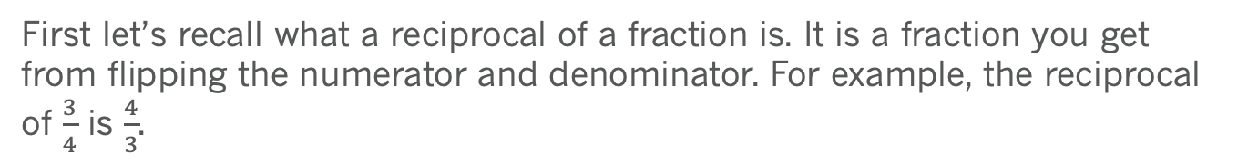
Rules for
Multiplication and Division
First let’s recall what a reciprocal of a fraction is. It is a fraction you get from flipping the numerator and denominator. For example, the reciprocal of $\frac{3}{4}$ is $\frac{4}{3}$.
Multiplication of fractions: multiply values in the numerator together, over the values in the denominator multiplied together.
Division of fractions: keep the first fraction, change the division into multiplication, and flip the second fraction (to turn it into its reciprocal).

Slide 14
Let’s Practice!

Slide 15
Scientific Applications
Fractions are applicable outside of math and food! We can use fractions when it comes to finances, and things that are part of everyday of our lives. Like driving: we get miles per gallon from fractions. Here are some scientific applications where fractions apply, but are not limited to:
Physics: expressing quantities such as speed and acceleration
Biology: expressing ratios of different types of cells in a tissue
Chemistry: describing ratios of elements in compounds, balancing equations

Slide 16
Chemistry Examples
Solution: 2C₁₀H₂₂+31O₂ 20CO₂+22H₂O

Slide 17


Thanks for Coming!
1. Workshop Survey:
https://forms.gle/D6MqNV48SnSWPuNQ8
2. More QSC Workshops and Events:

